Slide 1

WELCOME
IsDB-BISEW

Slide 2

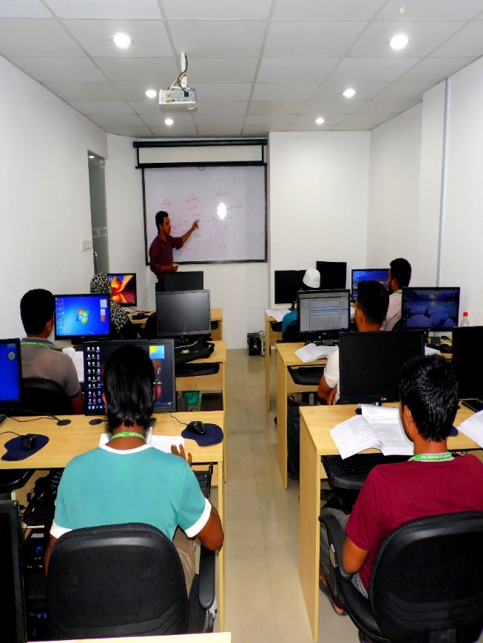
Grooming Session
Introductory Speech
Md. Helalur Rahman & Md. Shariful Islam

Slide 3
A Standard & Complete CV
Complete your CVs at Career Hub
Make sure you have added a recent photo
Fill in every field properly
Present and permanent address must be filled in detail (mention your House no, Rd, Area, Zip code, District, Police station, etc.)
Make sure your contact and email IDs are valid

Slide 4
A Standard & Complete CV
Insert your academic qualifications (Result Only Grade Point)
Add your projects & related information
Your role in the project (if group project)
Project Title
Tools and Technologies used
Project duration
Portfolio / Project links ( If your project is online)

Slide 5
Your Must Attention
Communicate with Placement Cell
Interview Call
If you get an interview call communicate immediately with the placement cell
Interview Preparation
Pursue scalable customer service through sustainable strategies​ Engage top-line web services with cutting-edge deliverables​
Prepare yourself for the upcoming interview. The placement cell will assist you with your interview preparation and will take the proper action.
Always maintain communication with the placements cell. Don’t hide any information that affects your placement.

Slide 6
Your Must Attention
Company Information
Job Requirements
Before facing an interview, you must know about the job requirements in detail.
Take Time if confused!
Pursue scalable customer service through sustainable strategies​ Engage top-line web services with cutting-edge deliverables​
Always be knowledgeable about the organization where you have applied.
Take assistance from the placement cell if required.
If you are confused about any issue related to your job placement, don’t give a decision in a hurry
Take time and inform the placement cell so that we can advise & assist you

Slide 7
Your Must Attention
Employer’s Tasks
Presentation Skills
Manner
Pursue scalable customer service through sustainable strategies​ Engage top-line web services with cutting-edge deliverables​
Don’t panic if the employer wants to make an agreement with you and keep your academic certificates. You should ask about the facilities they will provide by this time.
If the employer gives any assignment or task, you must immediately share it with the placement official ( who sent your resume) and finish the task within the deadline.
Do not copy each other’s assignment
Speak clearly and confidently in the interview
Be prepared to clearly describe the projects you have done
Be polite (give salaam and seek permission before entering or sitting)
Don’t be argumentative
Do not be afraid to ask questions

Slide 8
Your Must Attention
Placed Info
Salary
Salary depends on your job interview performance
You mustn’t join below 20,000 BDT.
Don’t indicate in any way that you are willing to join with a salary below 20,000.
Recruitment policy
Pursue scalable customer service through sustainable strategies​ Engage top-line web services with cutting-edge deliverables​
Immediate provide the details about your placement to the placement cell and provide a copy of your appointment letter
Don’t panic if the employer wants to make an agreement with you and keep your academic certificates
You should ask about the facilities they will provide during the lock-in period.

Slide 9
ICT Jobs in Bangladesh
Regularly visit various ICT job sites;
Analyzing employer’s job requirements in detail.
Find out your strengths and weakness in relation to the job

Slide 10
Individual Skills
You should have excellent communication skills
Fluent in English, written and spoken.
Strong operational execution and ability to collaborate with colleagues
Proactive & adaptable to fast-changing environment

Slide 11
Individual Skills
Strategic thinker who thrives in developing long-term technical solution
Ability to multitask, solve problems, and self-motivated
Has a quick learning approach: fail fast, learn fast, improve fast–if it works, keep it, otherwise dump it

Slide 12
Placement Cell
Placement cell sends CVs from Career Hub only.
Trainees must always be in touch with placement cell
Attending a job interview arranged by the placement cell is a must.
Cause of failing to attend the interview must be informed to the placement cell in advance.

Slide 13
Important Advise (Cont.)
Send an email / SMS of your interview information to Placement Cell (Interview date, Trainee ID, organization name) for tracking;
Inform the placement cell about your written exam date, organization name and Trainee ID;
If you are placed then immediately inform Placement Cell;
Send your appointment letter hard copy or send scan copy after getting job to the Placement Cell.

Slide 14
General Question for Interview
Tell us something about yourself;
What is your expected salary?
Why do you want to work here?
What are your strength & weaknesses?
Where do you see yourself in five years’ time?
Why should we hire you?
What do you know about this organization?
Note: Try to collect more sample question from placed graduates, Instructor and course consultant
Possible Answers

Slide 15
Important Advices
Some organizations have specific salary structures;
Do not think about salary first, think about your task;
Initial salary structure may be lower than expected;
Salary will be increased rapidly;
Don’t expect a high salary as a fresher;

Slide 16
List of Jobs Sites
http://www.bdjobs.com/
https://www.linkedin.com/jobs/
http://Facebook.com
http://www.job.com.bd/
https://www.careerjet.com.bd/
www.bdnews24.com/classifieds/jobs
www.uncareer.net/country/Bangladesh

Slide 17
List of important Study site
http://www.indiabix.com/ (IQ test question and logical questions)

Slide 18
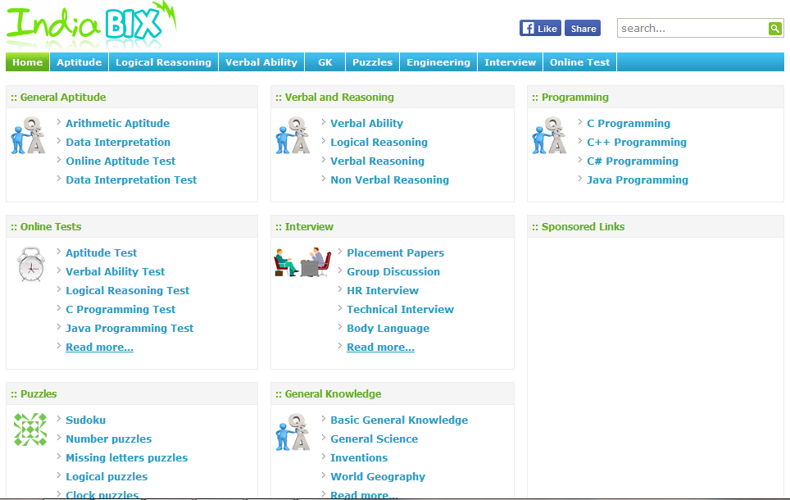

Slide 19
CV updating process in CareerHub
If you face any problem during updating your CV, Please Contact with CareerHub Admin at Show & Tell.
Mr. Azad - 01717- 842424

Slide 20
Send an email/SMS of your interview information to Placement Executive (Your Interview date, Trainee id, Name, Mobile Number & organization name) for tracking
If you are placed then you have to inform us.
Mr. Helalur Rahman
Program Officer (Placement)
01670-462007
helal@isdb-bisew.org
Mr. Shariful Islam
Placement Officer
01552-450991
sharif@isdb-bisew.org

Slide 21
Finally Job Appointment Letter/Placement Confirmation document Send to: Mobile : 01670-462007 helal@isdb-bisew.org

Slide 22
GOOD LUCK!

